Slide 1



s
e
c
o
n
d
C
O
R
N
A
N
I
T
H
I
S
11.22-12.6
A free CD of this message will be available following the service
It will also be available for podcast later this week at calvaryokc.com

Slide 2
NIV - and been exposed to death again and again.
O
A
N
S
11.22-12.6
I
I
s
e
c
o
n
d
C
R
N
T
H

Slide 3
O
A
N
S
11.22-12.6
I
I
s
e
c
o
n
d
C
R
N
T
H

Slide 4
Acts 14:19-20 - ¹⁹ Then Jews from Antioch and Iconium came there; and having persuaded the multitudes, they stoned Paul and dragged him out of the city, supposing him to be dead.
²⁰ However, when the disciples gathered around him, he rose up and went into the city. And the next day he departed with Barnabas to Derbe.
O
A
N
S
11.22-12.6
I
I
s
e
c
o
n
d
C
R
N
T
H

Slide 5
O
A
N
S
11.22-12.6
I
I
s
e
c
o
n
d
C
R
N
T
H

Slide 6
Deut. 25:3 - Forty blows he may give him and no more, lest he should exceed this and beat him with many blows above these, and your brother be humiliated in your sight.
O
A
N
S
11.22-12.6
I
I
s
e
c
o
n
d
C
R
N
T
H

Slide 7
O
A
N
S
11.22-12.6
I
I
s
e
c
o
n
d
C
R
N
T
H

Slide 8
Waters - potamos – river (running water)
O
A
N
S
11.22-12.6
I
I
s
e
c
o
n
d
C
R
N
T
H

Slide 9
O
A
N
S
11.22-12.6
I
I
s
e
c
o
n
d
C
R
N
T
H

Slide 10
St. Basil the Great (AD 330?-379) - “The labors of the farm do not seem strange to the farmer; the storm at sea is not unexpected by the sailor; sweat causes no wonder to the hired laborer; and so to those who have chosen to live the life of piety the afflictions of this world are not unforeseen. Nay, to each of the aforesaid is joined a labor that is appropriate
O
A
N
S
11.22-12.6
I
I
s
e
c
o
n
d
C
R
N
T
H

Slide 11
St. Basil the Great (AD 330?-379) - and well known to those who share it – a labor that is not chosen for its own sake, but for the enjoyment of expected blessings. For hopes, which hold and weld together man's entire life, give consolation for the hardships which fall to the lot of each of these.”
O
A
N
S
11.22-12.6
I
I
s
e
c
o
n
d
C
R
N
T
H

Slide 12
O
A
N
S
11.22-12.6
I
I
s
e
c
o
n
d
C
R
N
T
H

Slide 13
G. K. Chesterton - “Christianity has not been tried and found wanting; it has been found difficult and not tried.”
2 Cor. 12:9 (NIV) - Therefore I will boast all the more gladly about my weaknesses, so that Christ’s power may rest on me.
O
A
N
S
11.22-12.6
I
I
s
e
c
o
n
d
C
R
N
T
H

Slide 14
O
A
N
S
11.22-12.6
I
I
s
e
c
o
n
d
C
R
N
T
H

Slide 15
Acts 9:15-16 - ¹⁵ But the Lord said to him, “Go, for he is a chosen vessel of Mine to bear My name before Gentiles, kings, and the children of Israel. ¹⁶ For I will show him how many things he must suffer for My name's sake.”
O
A
N
S
11.22-12.6
I
I
s
e
c
o
n
d
C
R
N
T
H

Slide 16
O
A
N
S
11.22-12.6
I
I
s
e
c
o
n
d
C
R
N
T
H

Slide 17
NLT - Who is weak without my feeling that weakness? Who is led astray, and I do not burn with anger?
Phillips - Do you think anyone is weak without my feeling his weakness? Does anyone have his faith upset without my longing to restore him?
O
A
N
S
11.22-12.6
I
I
s
e
c
o
n
d
C
R
N
T
H

Slide 18
O
A
N
S
11.22-12.6
I
I
s
e
c
o
n
d
C
R
N
T
H

Slide 19
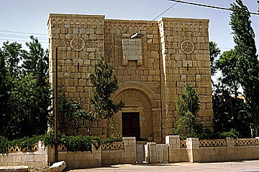
The window in the city wall of Damascus which tradition identifies as the place where Paul was lowered in a basket.
O
A
N
S
11.22-12.6
I
I
s
e
c
o
n
d
C
R
N
T
H

Slide 20
O
A
N
S
11.22-12.6
I
I
s
e
c
o
n
d
C
R
N
T
H

Slide 21
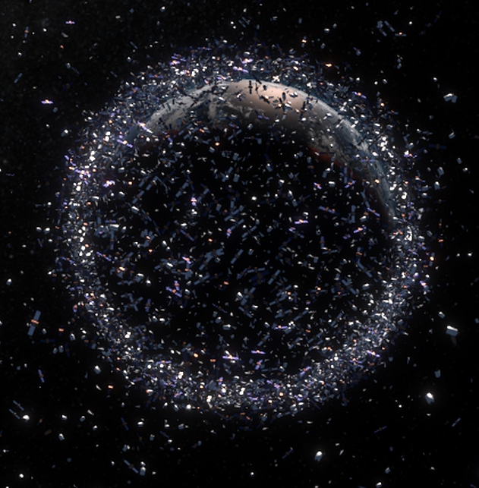
1st Heaven
(Atmosphere)
2nd Heaven
(Outer space)
3rd Heaven
(Throne of God)
O
A
N
S
11.22-12.6
I
I
s
e
c
o
n
d
C
R
N
T
H

Slide 22
Caught up - harpazō – Latin, rapio
1 Thess. 4:17 - Then we who are alive and remain shall be together with them in the clouds to meet the Lord in the air.
Rapio-ed
Caught up
O
A
N
S
11.22-12.6
I
I
s
e
c
o
n
d
C
R
N
T
H

Slide 23



Paul’s visit to the 3rd heaven
Paul stoned at Lystra
2 Corinthians written
AD 42
AD 44
AD 46
AD 48
AD 50
AD 52
AD 54
AD 56
14 years
O
A
N
S
11.22-12.6
I
I
s
e
c
o
n
d
C
R
N
T
H

Slide 24
O
A
N
S
11.22-12.6
I
I
s
e
c
o
n
d
C
R
N
T
H

